Slide 1
Quantifying Information Leakage of Deterministic Encryption
Mireya Jurado and Geoffrey Smith
November 11, 2019
CCSW 2019: Cloud Computing Security Workshop

Slide 2
Challenge
We want to store sensitive data remotely
Encrypted databases aim to balance security and functionality
Diabetes
Measles
Measles
Stroke
Diabetes
Measles
Xq2gZZ
pg73Qq
pg73Qq
w5KL2z
Xq2gZZ
pg73Qq
Question: How do you measure information leakage of deterministic encryption?
Notes:
to explore this, I'll be using a running example of health database. each have a disease. only 3 diseases for simplicity. want to evaluate under operational scenario

Slide 3
Quantitative Information Flow (QIF)
System
Secret input X
Observable output Y
Diabetes
Measles
Measles
Stroke
Diabetes
Measles
Xq2gZZ
pg73Qq
pg73Qq
w5KL2z
Xq2gZZ
pg73Qq
The database column of diseases, drawn independently according to some prior distribution δ on diseases
The deterministic encryption of the column, modeled as a random permutation (the “ideal object”)
Notes:
Quantitative information flow gives ways to quantify the amount leakage in a system taking a secret input X to an observable output Y.
We want to quantify the leakage caused by deterministic encryption. Here X is a database column of diseases, drawn independently according to some prior distribution on diseases. And Y is the deterministic encryption of the column, modeled as a random permutation which is the “ideal object”.
adversary is information theoretic and has knowledge of a prior

Slide 4
Quantitative Information Flow Concepts
probability
n
Notes:
I want to introduce some QIF concepts
Let n be the length of the column (the number of patients)

Slide 5
Quantitative Information Flow Concepts
probability
Prior vulnerability:
Adversary’s probability of accomplishing goal given only δ
n
Notes:
We can first calculate prior vulnerability,

Slide 6
Quantitative Information Flow Concepts
Posterior vulnerability:
Adversary’s probability of accomplishing goal given δ and output Y
probability
Prior vulnerability:
Adversary’s probability of accomplishing goal given only δ
n
Notes:
We can also calculate posterior vulnerability

Slide 7
Quantitative Information Flow Concepts
Posterior vulnerability:
Adversary’s probability of accomplishing goal given δ and output Y
Leakage:
The difference between prior and posterior vulnerability
probability
Prior vulnerability:
Adversary’s probability of accomplishing goal given only δ
n

Slide 8
Intuition of Model
Xq2gZZ
c
Disease | Probability $δ$
a | $$1/2$$
b | $$1/3$$
c | $$1/6$$
pg73Qq
b
pg73Qq
w5KL2z
a
Xq2gZZ
pg73Qq
Notes:
Before I show the results, I want to quickly illustrate the intuition behind our model of deterministic encryption
Let’s say the probability of disease a is ½, ,…,
The encrypted database column can be organized into blocks.
Given this distribution there is an obvious guessing strategy: that the biggest block is a, the medium block is b and the small block is c

Slide 9
Results: Bayes Scenario
Goal: guess the entire secret in one try
Notes:
and assume for simplicity that there are just 3 possible diseases, which we would like to evaluate under several possible distributions
**
The first is the Bayes scenario, under which an adversary aims to guess the entire secret column in one try.

Slide 10
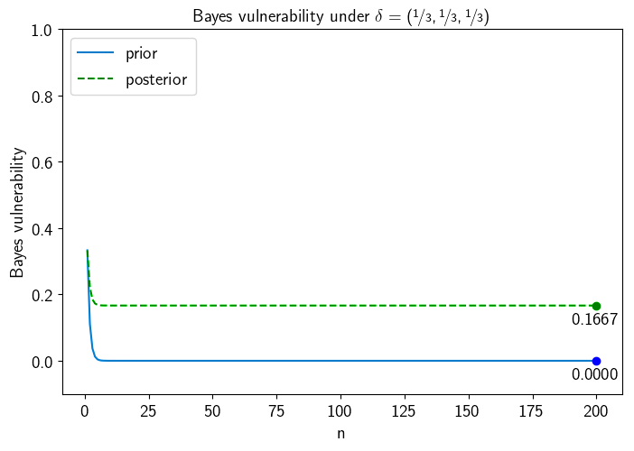
Results: Bayes Scenario
Goal: guess the entire secret in one try
Notes:
These graphs show prior and posterior vulnerability as a function of n, from 1 – 200.
Uniform: blue curve shows an adversary who just knows the prior distribution attempting to guess the entire column.

Slide 11
Results: Bayes Scenario
Goal: guess the entire secret in one try
Prior Vulnerability:
When n = 1:
?
$$1/3$$
Notes:
If you look at the very left end (n = 1), the blue curve is 1/3. If you have just a single disease, guess a b c

Slide 12
Results: Bayes Scenario
Goal: guess the entire secret in one try
Prior Vulnerability:
When n = 1:
?
$$1/3$$
When n is large:
?
$${1/3}^{n}$$
?
?
?
?
?
Notes:
As n grows, the adversary will have to guess the disease at every index and the probability quickly goes to 0 (1/3 ^ nth)

Slide 13
Results: Bayes Scenario
Goal: guess the entire secret in one try
Notes:
The green line: how well the adversary can do given the output which tells you the way the column is broken into blocks.
We can observe that the posterior curve is going to 1/6^{th.}

Slide 14
Results: Bayes Scenario
Goal: guess the entire secret in one try
Posterior Vulnerability:
When n is large:
?
$$1/6$$
?
?
Notes:
Once n is large, we can generally expect 3 blocks. The adversary will have to guess which is which and there’s 6 possible ways the diseases could be allocated to the 3 blocks.

Slide 15
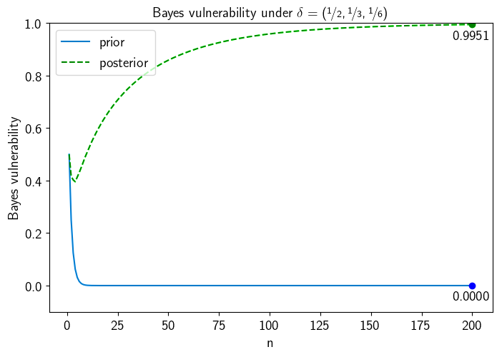
Results: Bayes Scenario
Goal: guess the entire secret in one try
Notes:
Now we turn to the non uniform case.
The prior vulnerability represented by the blue line again goes to 0,

Slide 16
Results: Bayes Scenario
Goal: guess the entire secret in one try
Posterior Vulnerability:
When n is large:
c
grows to 1
b
a
Notes:
but the posterior vulnerability represented by the green line, as explained in the previous intuition, sees that as n grows, we will likely see a large block, a medium block and a small block which the adversary will be able to reliably map to a, b, and c, and her success rate will go up to 1.

Slide 17
Results: Bayes Scenario
Goal: guess the entire secret in one try
Notes:
As we can see, information flow changes based on the prior of the secret

Slide 18
Results: Single Index Scenarios
Goals: (1) free to guess any patient’s disease and (2) forced to guess a specified patient’s disease
Notes:
Jointly referred to as ‘single index’. Graphed on same axis to compare, but do represent different operational scenarios

Slide 19
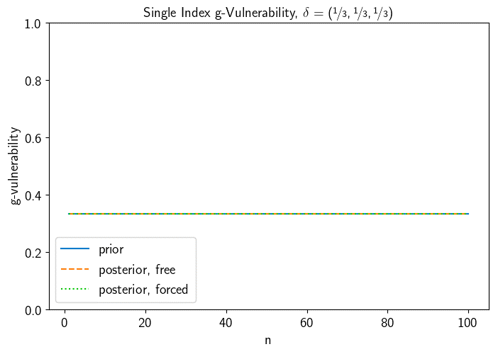
Results: Single Index Scenarios
Goals: (1) free to guess any patient’s disease and (2) forced to guess a specified patient’s disease
Notes:
In the uniform case, the three lines coincide—in these scenarios with this prior, there is no leakage

Slide 20
Results: Single Index Scenarios
Goals: (1) free to guess any patient’s disease and (2) forced to guess a specified patient’s disease
Posterior Vulnerability:
$$1/3$$
Seeing the blocks does not help
?
Notes:
Seeing how the column breaks into blocks is useless in trying to determine the value of a specific entry.
Vs Bayes, with considerable leakage.

Slide 21
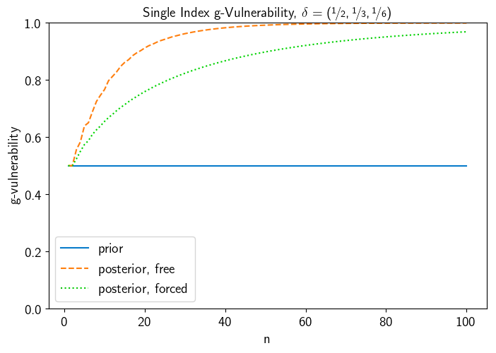
Results: Single Index Scenarios
Goals: (1) free to guess any patient’s disease and (2) forced to guess a specified patient’s disease
Notes:
Now let’s turn to the nonuniform prior

Slide 22
Results: Single Index Scenarios
Goals: (1) free to guess any patient’s disease and (2) forced to guess a specified patient’s disease
Prior Vulnerability:
?
?
$$1/2$$
?
?
?
?
Notes:
On the nonuniform case, the blue line shows that there is a ½ chance of guessing an index correctly a priori.

Slide 23
Results: Single Index Scenarios
Goals: (1) free to guess any patient’s disease and (2) forced to guess a specified patient’s disease
Posterior Vulnerability (free):
?
Goes up to 1
Notes:
In the free scenario the adversary can guess about whatever block is most advantageous to guess about and the vulnerability goes up to 1 very quickly

Slide 24
Results: Single Index Scenarios
Goals: (1) free to guess any patient’s disease and (2) forced to guess a specified patient’s disease
Posterior Vulnerability (forced):
?
Grows slower
Notes:
but in the forced scenario, the adversary may be forced to guess about a block she isn’t sure about, and so the vulnerability goes up slower.

Slide 25
Results: Single Index Scenarios
Goals: (1) free to guess any patient’s disease and (2) forced to guess a specified patient’s disease
Notes:
Again, we can see the leakage changes depending on the prior

Slide 26
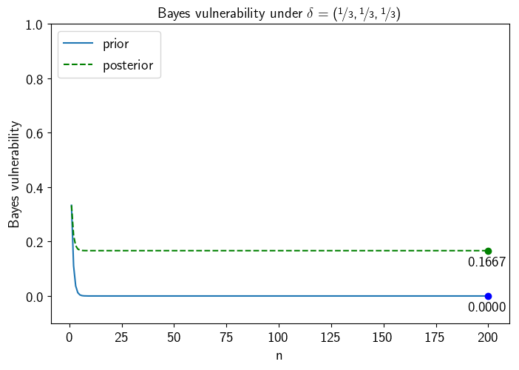
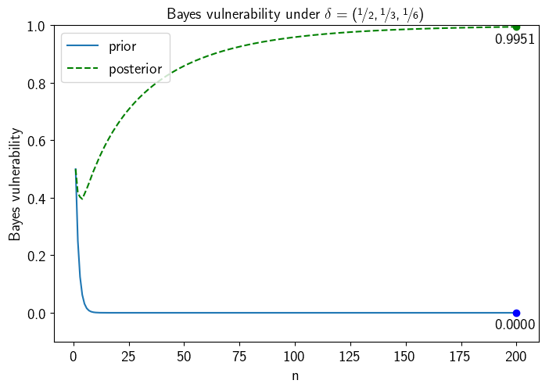
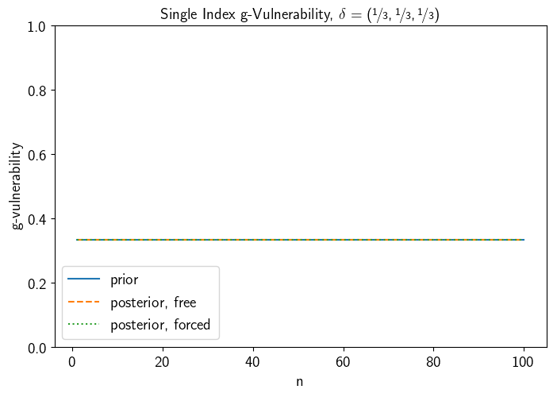
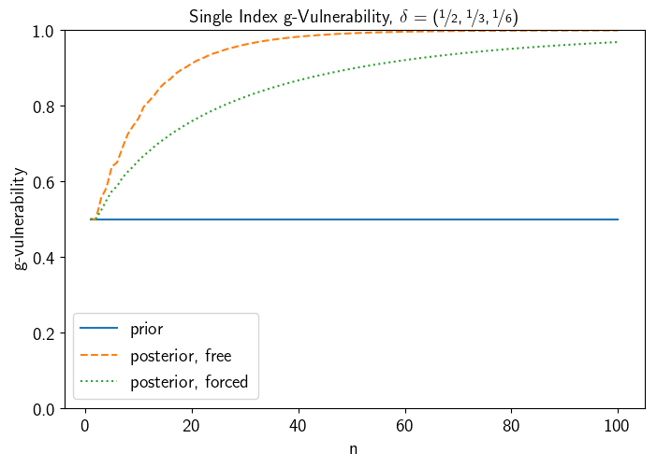
Leakage Depends on Prior and Operational Scenario

Slide 27
Leakage Depends on Prior and Operational Scenario

Slide 28
Results: Single Index Scenarios
Goals: (1) free to guess any patient’s disease and (2) forced to guess a specified patient’s disease
Notes:
Let’s go back to the single index graphs for a second.
These graphs summarize very complicated stories.

Slide 29
Results: Single Index Scenarios
Goals: (1) free to guess any patient’s disease and (2) forced to guess a specified patient’s disease
Notes:
We can see where n = 12 on the free orange line, the posterior vulnerability is around .8
Let’s walk through where the .8 is coming from

Slide 30
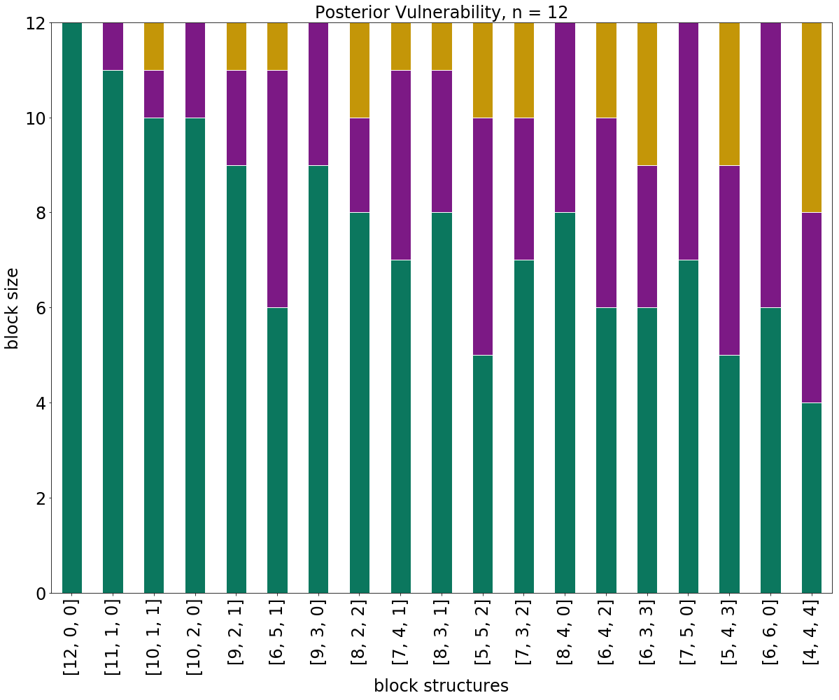
An In Depth View
19 possible block structures
Notes:
This graph illustrates all the possible block structures you could see in terms of sizes of the blocks.

Slide 31
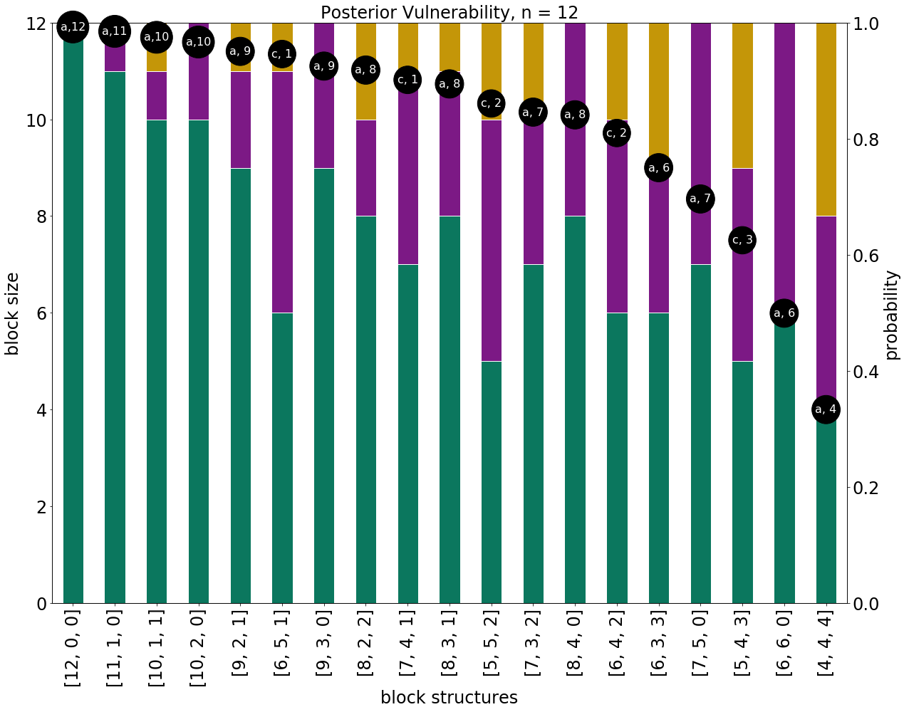
An In Depth View
19 possible block structures
Dots: the best guess and her probability of being correct

Slide 32
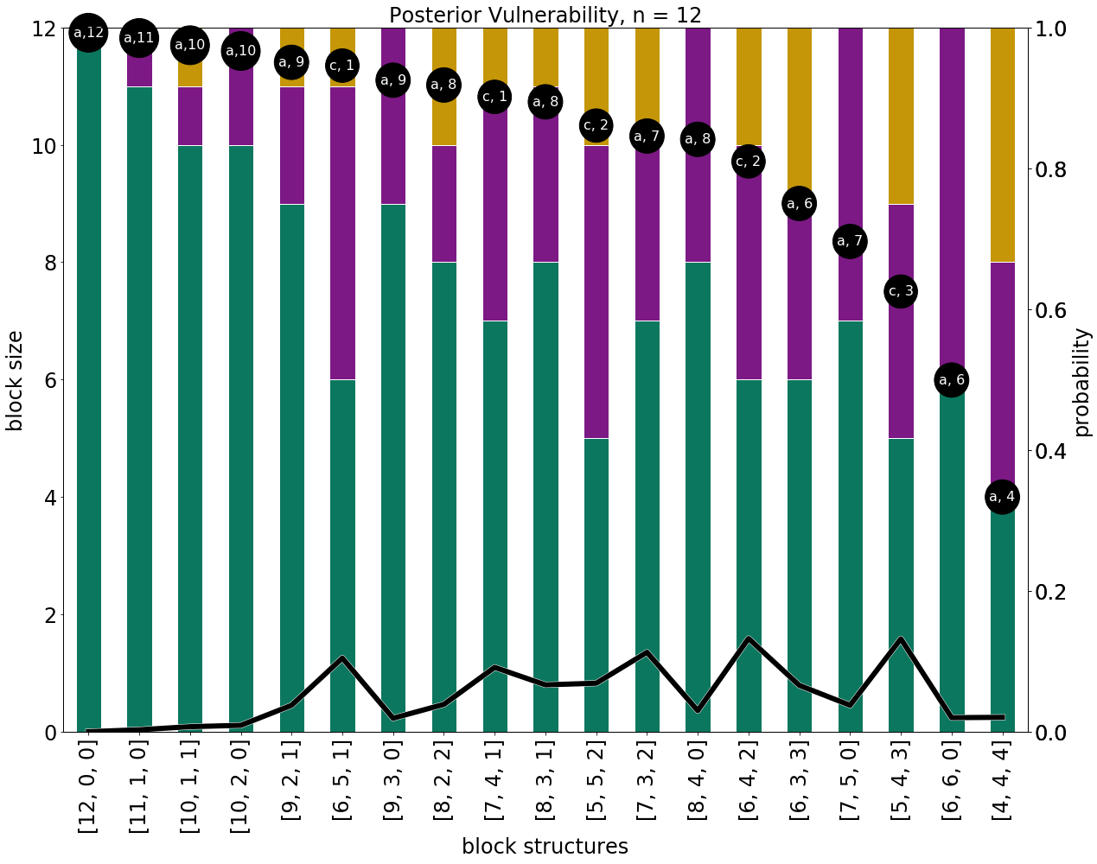
An In Depth View
19 possible block structures
Dots: the best guess and her probability of being correct
Line: the probability the block structure will occur

Slide 33
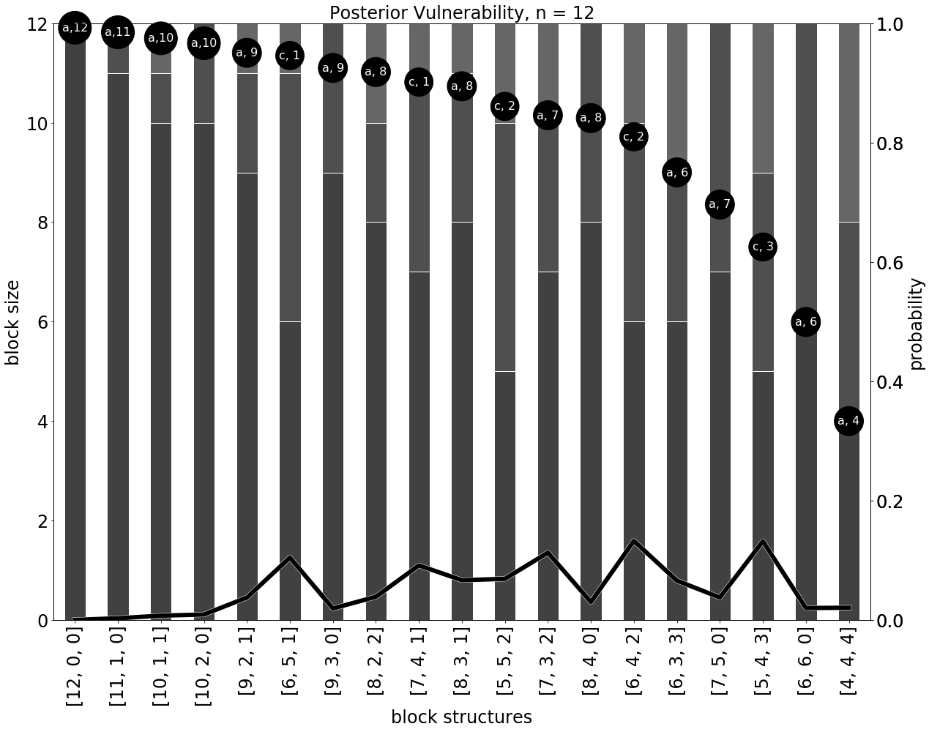
An In Depth View
19 possible block structures
Dots: the best guess and her probability of being correct
Line: the probability the block structure will occur

Slide 34
An In Depth View
19 possible block structures
Dots: the best guess and her probability of being correct
Line: the probability the block structure will occur

Slide 35
An In Depth View
19 possible block structures
Dots: the best guess and her probability of being correct
Line: the probability the block structure will occur
Posterior vulnerability: ~0.813

Slide 36
Contributions
Revealed that there are scenarios where deterministic encryption is not safe even under a uniform prior.
Demonstrated a novel security framework by coupling the provable security approach of modern cryptography with QIF theory.
Illustrated that there is no one ‘right’ way to quantify leakage. Information flow depends on the operational scenario.
Notes:
Especially with large ns such as a hospital database.
Important first step into precisely discussing leakage in this domain
Key takeaway : no one right way

